Slide 1
FLOOD MONITORING AND EARLY WARNING SYSTEM

Slide 2
Problem understanding
An overflow of a large amount of water beyond its normal limits, especially over what is normally dry land. A flood is an overflow of water that submerges land .In the sense of “flowing water”, the word may also be applied to the inflow of the tide. Floods are an area of study of the discipline hydrology and are of significant concern in agriculture, civil engineering and public health. Flooding may occur as an overflow of water from water bodies, such as a river, lake, or ocean, in which the water overtops or breaks levees, resulting in some of that water escaping its usual boundaries, or it may occur due to an accumulation of rainwater on saturated ground in an area flood. While the size of a lake or other body of water will vary with seasonal changes in precipitation and snow melt, these changes in size are unlikely to be considered significant unless they flood property or drown domestic animals. Some floods develop slowly, while others such as flash flood scan develop in just a few minutes and without visible signs of rain

Slide 3
Solution to the problem
The technology has been developed gigantically in order to prevent loss of life. This project is totally based on informing the civilians about the upcoming flood so that they can evacuate the danger area before the flood hits. For detecting the rise in water level Ultrasonic Sensor and Water Level Sensor is used. For detecting the change in humidity and temperature Humidity and Temperature Sensor is used. The data from the DTH11 and HC-SR04 is read by the microcomputer and analyze the data in order to detect the level of water. If the level of water is less than the defined threshold value then the microcomputer turns the LED and buzzer on. Furthermore, the data obtained from the microcomputer is uploaded to the database. The values of the sensors updating in real time can be monitored in database table. The content of the database table is now linked with the web API (Application Programming Interface) and trigger is set. And now when the level of water crosses the threshold value the trigger is triggered and the web API sends the SMS to the phone number registered to it.

Slide 4
The main objectives of the project are:
To read the temperature and humidity of the environment continuously
To warn the people through SMS system using web API
To detect the level of water in real time

Slide 5
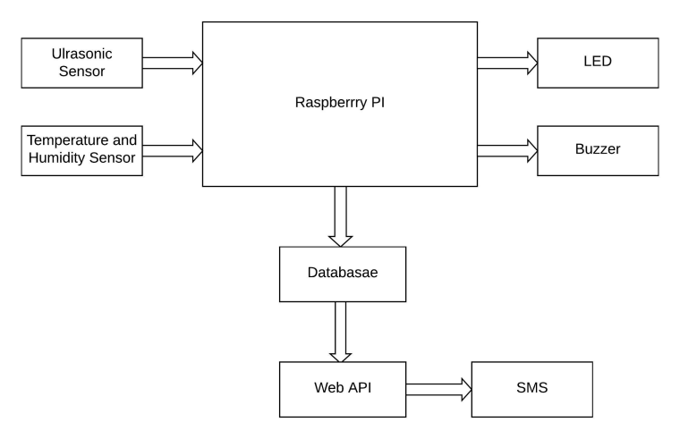
System Block Diagram
The block diagram of the overall system is shown in the figure below. The sensors placed at the different places reads the data which are manipulated through the microcontroller and the values of the sensors are displayed. The values obtained repeatedly are send to database and through the web API, warning message is sent into the phone.

Slide 6
The raspberry Pi used is the brain of the project. It is responsible for acquiring, processing, storing and communicating the information from sensors, and then executing the events respectively. Raspberry reads the data from the Ultrasonic sensor (HCSR04) and Temperature and Humidity sensor (DHT11). Then the Raspberry pi
processes the obtained value of the sensor and displays it. The value from the Ultrasonic sensor is used to determine the level of water. The certain threshold value for the distance between the ultrasonic sensor and the river is fixed The value of distance obtained from the ultrasonic sensor is updated repeatedly with the change in the water level. If the value of the distance is less than the fixed threshold value then the led and buzzer will turn on which signifies that there is high chances of occurring flood. The date and time is auto incremented since it doesn’t require any sensor input data. The values of temperature and the humidity changes corresponding to the changes in the environmental temperature and humidity and gets updated in the database table. The main role here is of the ultrasonic sensor. The value of the ultrasonic sensor is updated repeatedly in certain interval of time and shows the distance. If the value of the distance is less than the threshold value then the warning message regarding flood will be displayed in the remarks and if the value of the distance is greater than the threshold value then remarks will display default message. The data in the database table are updated automatically every 6 seconds. Now, the main motive of the system to alert the people about the coming flood is done by the web API.

Slide 7
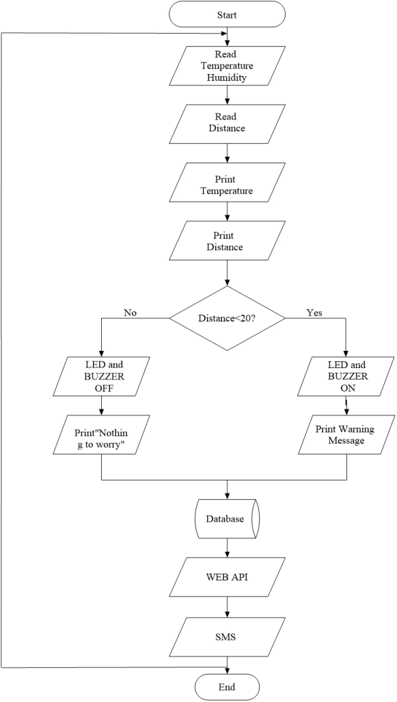

Slide 8
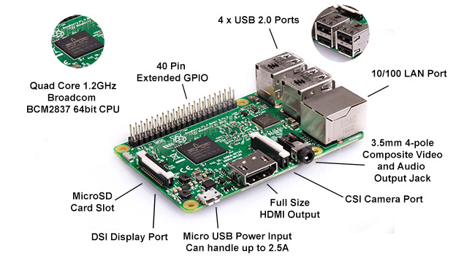
Hardware Description
Raspberry Pi
The Raspberry Pi is a low cost, credit-card sized computer that plugs into a computer monitor or TV, and uses a standard keyboard and mouse. It is a capable little device that enables people of all ages to explore computing, and to learn how to program in languages like Scratch and Python. It’s capable of doing everything you’d expect a desktop computer to do, from browsing the internet and playing high-definition video, to making spreadsheets, word-processing, and playing games. the Raspberry Pi has the ability to interact with the outside world, and has been used in a wide array of digital maker projects, from music machines and parent detectors to weather stations and tweeting birdhouses with infra-red cameras. We want to see the Raspberry Pi being used by kids all over the world to learn to program and understand how computers work.

Slide 9
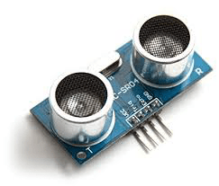
Ultrasonic Sensor
The sensor head emits an ultrasonic wave and receives the wave reflected back from the target. Ultrasonic Sensors measure the distance to the target by measuring the time between the emission and reception. It uses a single ultrasonic element for both emission and reception. In a reflective model ultrasonic sensor, a single oscillator emits and receives ultrasonic waves alternately. This enables miniaturization of the sensor head.
Specifications:
a. Operating voltage: +5V
b. Theoretical Measuring Distance: 2cm to 450cm
c. Practical Measuring Distance: 2cm to 80cm
d. Accuracy: 3mm
e. Measuring angle covered: <15°

Slide 10
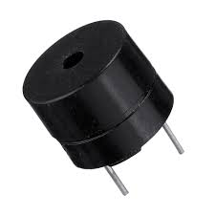
Buzzer
A buzzer is a device which makes a buzzing or beeping noise. This type of buzzer requires some kind of oscillator to drive it—if you apply a DC voltage you will just get a click. They are used in places where you need something that emits an audible tone, but don’t care about high-fidelity sound reproduction, like microwave ovens, smoke alarms, and electronic toys.
Specifications
a. Rated Voltage: 6V DC
b. Operating Voltage: 4-8V DC
c. Rated current: <30mA
d. Sound Type: Continuous Beep
e. Resonant Frequency: ~2300 Hz
f. Small and neat sealed package

Slide 11
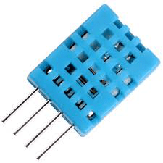
Temperature and Humidity Sensors (DHT11)
Temperature sensors measure air temperature, while humidity sensors measure air humidity. The calculation of the air humidity does not directly influence a wind site assessment, but knowing this parameter helps assessing the potential danger of ice build-up at the measuring location. Temperature sensors should always be mounted at a height of at least 10m to ensure sufficient distance from heat radiating from the earth. This DHT11 Temperature and Humidity Sensor features a calibrated digital signal output with the temperature and humidity sensor capability. It is integrated with a high-performance 8-bit microcontroller. Its technology ensures the high reliability and excellent long-term stability
Specification
a. Supply Voltage: +5 V
b. Temperature range: 0-50 °C error of ± 2 °C
c. Humidity: 20-90% RH ± 5% RH error

Slide 12
PCB Wizard
PCB Wizard is a powerful package for designing single-sided and double-sided printed circuit boards (PCBs).
It provides a comprehensive range of tools covering all the traditional steps in PCB production, including schematic drawing, schematic capture, component placement, automatic routing, Bill of Materials reporting and file generation for manufacturing.

Slide 13
Limitation
As no any machine can be perfect and this line also affect out project as well. Desired output was observed. The system designed has the following limitation:
DHT11 sensor can measure the temperature only from 0-50 degree Celsius and cannot operate on lower or higher range of temperature than this.
DHT11 sensor can measure the humidity only from 20-95% RH and hence cannot operate on lower or higher range than this.
HC-SR04 (Ultrasonic sensor) has the maximum range of only 400 centimeters.
The web API delays sometime to deliver the SMS.

Slide 14
Advantages
Timely detection of possible flood risks and floods.
Highly reliable and available real-time data.
Tailored solution that can be integrated with external developments at any level (device, connectivity, cloud or user application).
Total adaptation and integration with emergency plans.
Creation of historic data for Administration

